Slide 1
Sensors & Actuators
Unit - II

Slide 2
Topics to be covered
Voltage requirements for Sensors
Working of Sensors
Need of ADC while working with Analog Sensors
Working of Actuators
Need of relay while working with Actuators

Slide 3
Voltage considerations for Sensors
Transducers: A Transducer basically converts some form of energy into some other form, includes sensors used to measure temperature, pressure, force, strain, liquid levels and flow rates and electrical conductivity.
Sensors come with 2 different operating voltage rating: 3.3 V & 5 V.
Some sensors and actuators are of 12V or using AC voltages as well.
Which might not be compatible with what Arduino generates.
Arduino Uno board has 2 different pins available for 5V and 3.3 V, which should be provided accordingly to the sensor while interfacing it with the Arduino board.
If we apply the wrong Vcc pin to the sensor, its working capability may affect and we may get the wrong output, or the sensor could stop working altogether.

Slide 4
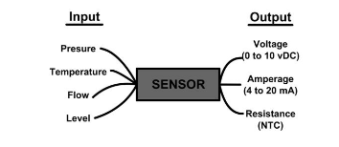
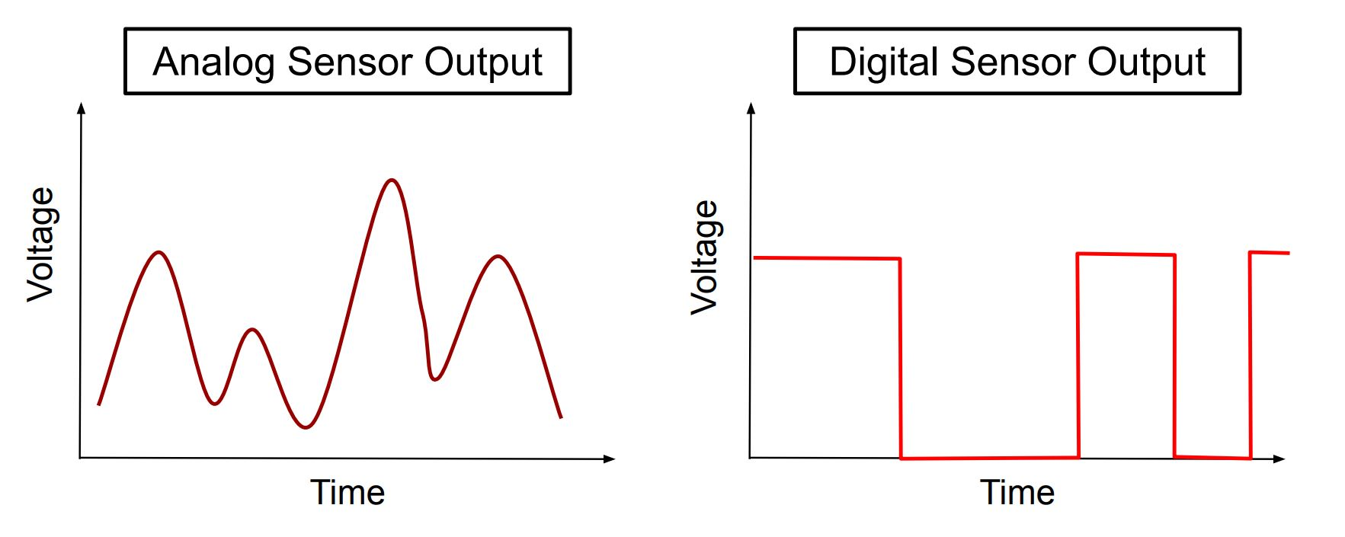
Sensor Classification
Sensors can be classified into 2 categories based on its output signal type:
Analog Sensors: Gives an analog voltage as an output, usually some conversion to digital is needed while interfacing this signal with some processor boards, because processor boards are digital devices.
Example: Sharp IR Sensor, Accelerometer, LDR, Sound Sensors etc.
Digital Sensors: Gives binary or digital data as output. No conversion is needed.
Example: PIR Sensor, Digital Accelerometer, Digital Temperature Sensor etc.
Sensors can also be classified into 2 categories based on power source:
Active Sensors: Active sensors provide their own source of energy to illuminate the objects they observe
Example: Sharp IR Sensor, Active Speed monitoring sensor, Ultrasonic Distance Sensor etc.
Passive Sensors: passive sensors detect energy emitted or reflected from the environment
Example: PIR Sensor, LDR etc.

Slide 5
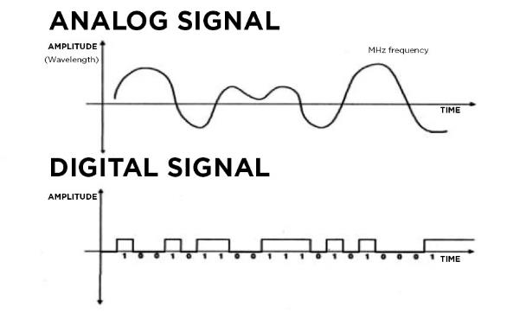
Generic working of Sensors
Sensors identify the presence of energy or changes that occur or to allow the transfer of energy.
Sensors receives signal through a Transducer and starts responding by converting into validate output to be easily understood.
Commonly sensors change over a perceived signal into an analog or digital signal.

Slide 6

Sensor Classification: Analog Sensors
An analog sensor will usually have two or three wires.
Physical quantities such as Temperature, Speed, Pressure, and Displacement are all analog quantities due to their continuous nature.
Pros:
Less quantization errors, low cost and requires less b/w
Accurate since recording data is done through continuous wave forms to represent information.
Configuring fault components is easier
Good lifespan
Low Weather dependencies
Not expensive and easy to handle
Cons:
Analog sensors have unwanted variation when noise gets added.
Due to the noise effect its consistence will be reduced and being reduced to its quality also.
Transmitter and Receiver should be configured if there is a change in the deployment level.
Security isn’t there for transmitting data.

Slide 7
Sensor Classification: Digital Sensors
Digital Sensors produce discrete digital output signals or voltages that digitally represent the measured quantity.
Responses with binary values
output as a single “bit” (serial transmission), or by combining the bits to produce a single “byte” output Ex: 0 , 1, or 01011110
Pros:
Easy to implement, free from observational errors
Noise immune without any deterioration
Fast handling, less demanding for storage, resistance to noise, conceivable outcomes, simple convey ability
Flexibility with framework change, utilization of receiver and Transmitter
Security includes great encryption transmission
Spare the information and recover when required
Cons:
Less accurate because it samples analog wave forms into few numbers and records them
Higher cost and depends on weather conditions
Have quantization errors, less accurate to finite set of data
Sampling error is most basic on many cases

Slide 8
Sensor Comparison: Analog v/s Digital
 | Analog Sensor | Digital Sensor
Signal | Continuous Signal | Discrete Signal
Representation | Continuous value to represent info. | Discrete value to represent info
Data Transmission | Prone to noise while transmission | Can be noise immune
Technology | Records signal/waveform as it is | Sampling of waveform
Uses | Light, sound, pressure sensing | Temprature
Bandwidth | Consume less bandwidth | Consumes more bandwidth
Memory | Stored as waveforms | Stored as binary information
Cost | Low | Higher
Power | Use Large power | Use very less power
Noise Response | Noise may affect waveform | Immune to noise during transmission
Error | Observational/Measurement error | No observational error
Example | LDR, sound sensors, pressure sensors, and analog temperature sensors | Humidity sensor, Flow sensor, Accelerometer, Level sensor

Slide 9
Sensor Classification
Sensors can also be classified into different categories based on type of working or the technology used for sensing the data:
IR Sensors
Ultrasonic Sensors
Light Sensors
Speed Sensors
Sound Sensors
Image Sensors
Proximity Sensors
Temperature/Humidity Sensors
Touch Sensors
Pressure Sensors etc.

Slide 10
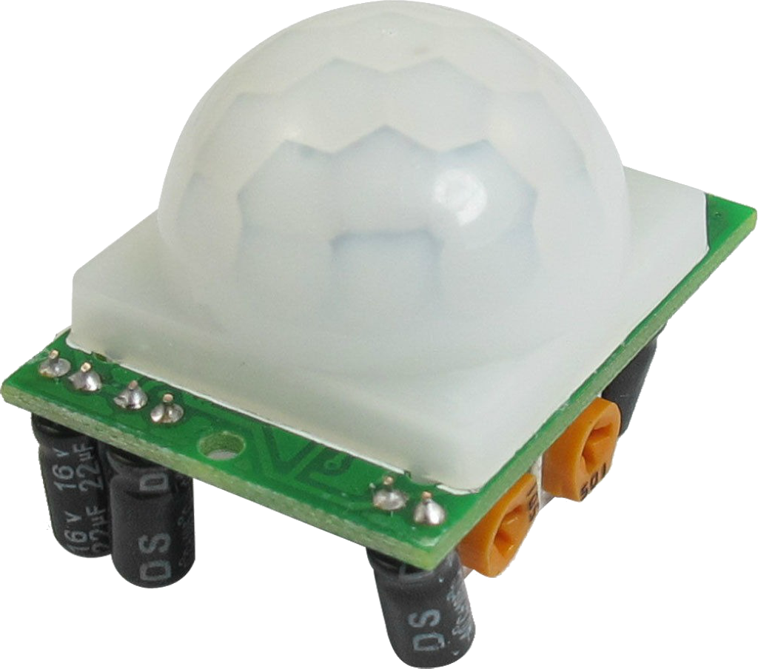
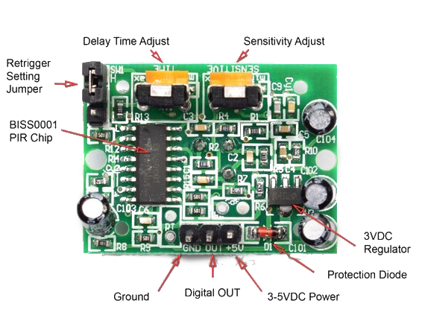
Sensors: PIR Motion Sensor
Passive Infrared Motion Sensor
Used to detect motion.
Digital sensor, output can be read from Digital OUT pin
Sensitivity: up to 20 feet (6 meters) 110° x 70° detection range, can be adjusted by potentiometer
Pins:
VCC (Power Input) : 5V
GND (Ground)
OUT (Digital Output - Motion Detection)

Slide 11
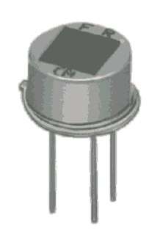
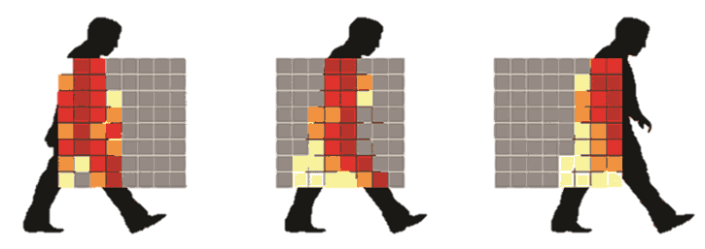
Sensors: PIR Motion Sensor
All living objects emit heat in terms of infrared radiation, thermal radiation
Passive Infrared Sensor detects such infrared radiation
PIR Sensor does not generate or radiate any energy for detection purposes.
made of a pyroelectric sensor, detects levels of infrared radiation.
Every object emits some low-level radiation and the hotter
objects emit more radiation.

Slide 12
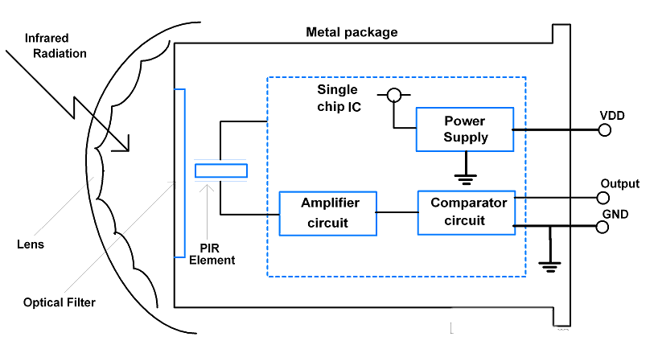
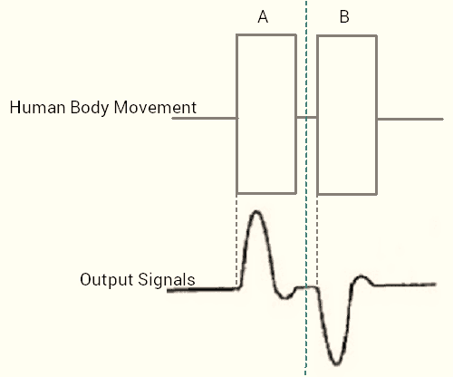
Sensors: PIR Motion Sensor
The sensor is split in two slots, which are wired up so that they cancel each other out.
If one half sees more or less IR radiation than the other, the output will swing high or low.
Input signals from both terminals of PIR element are amplified using an amplifier circuit and compared using a comparator circuit.
The PIR element is covered by the lens to increase the range of operation.

Slide 13
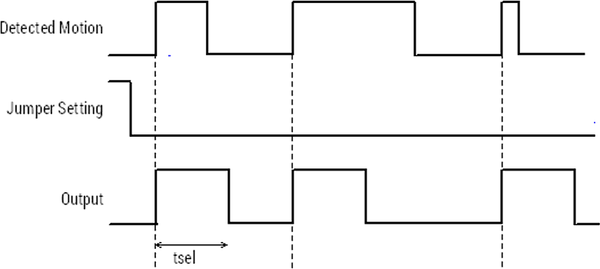
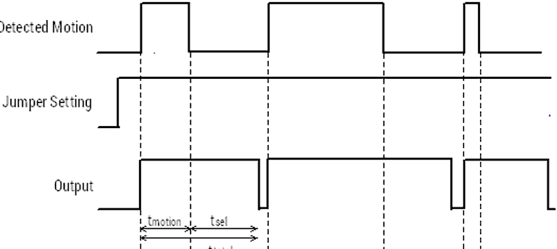
Sensors: PIR Motion Sensor
PIR has 2 working modes:
Single Trigger Mode:
jumper setting on PIR sensor set on LOW
Output goes HIGH when motion is detected
After specific delay (tsel) the output goes to LOW even if the object is in motion
output is LOW for some time and again goes HIGH if the object remains in motion
Delay (tsel) is provided by using the potentiometer on Sensor
Repeat Trigger Mode:
Jumper setting on PIR sensor set on High
Output goes HIGH when motion is detected
Output of PIR sensor is HIGH until the object is in motion
When the object stops motion, or disappears from the sensor area, the PIR continues its HIGH state up to some specified delay (tsel)

Slide 14
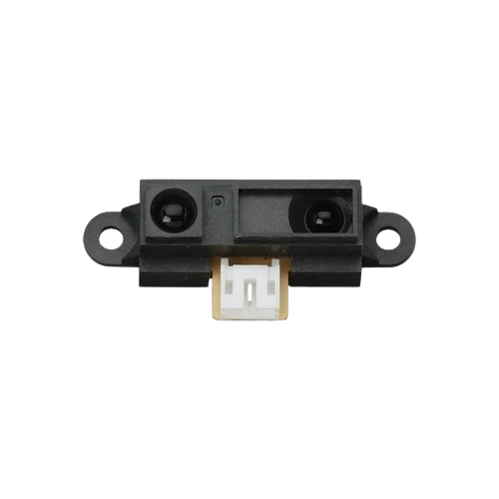
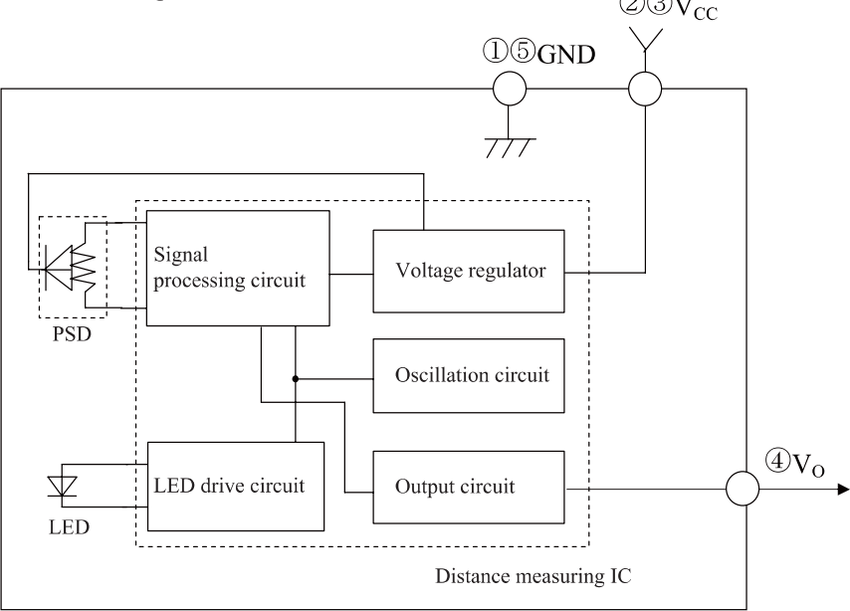
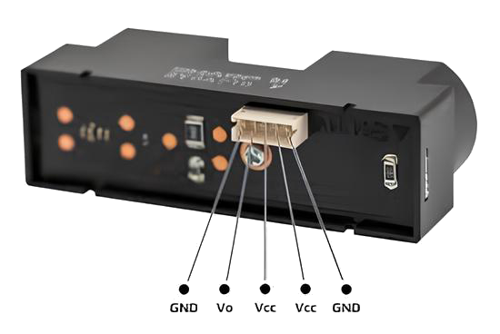
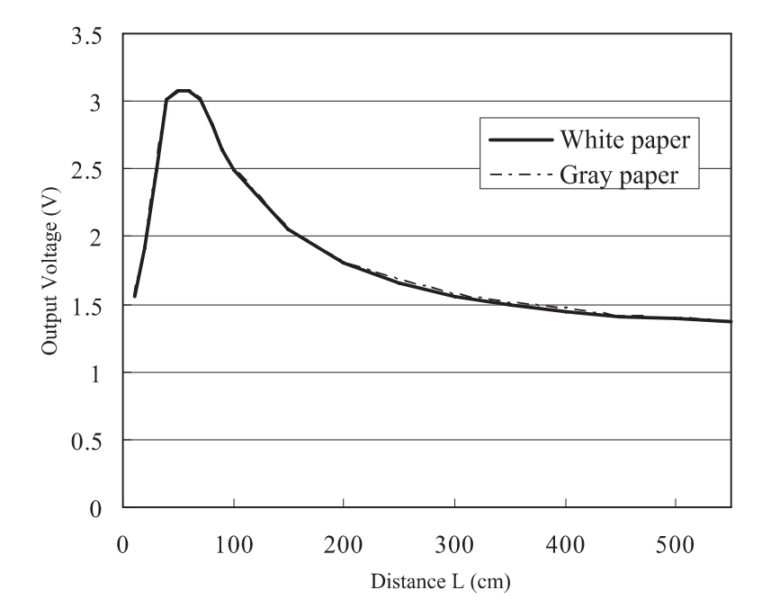
Sensors: Sharp IR Distance Sensor
Measures distance using infrared light
Consists integrated combination of PSD(position sensitive detector), IRED(infrared emitting diode) and signal processing unit.
Outputs voltage corresponding to the detection distance.
Range varies according to model, generally between 4cm to 150cm
Analog sensor, output can be read as voltage difference between V0 pin and Vcc
110° x 70° detection range, sensitivity can be adjusted by changing voltage
Pins:
VCC (Power Input) : 5V
GND (Ground)
Vo (Analog Output - Distance Measurement)
Application:
Projector(Auto-focus)
Robot cleaner
Auto-switch for illumination
Human detector
Game play etc.

Slide 15
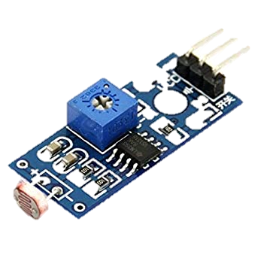
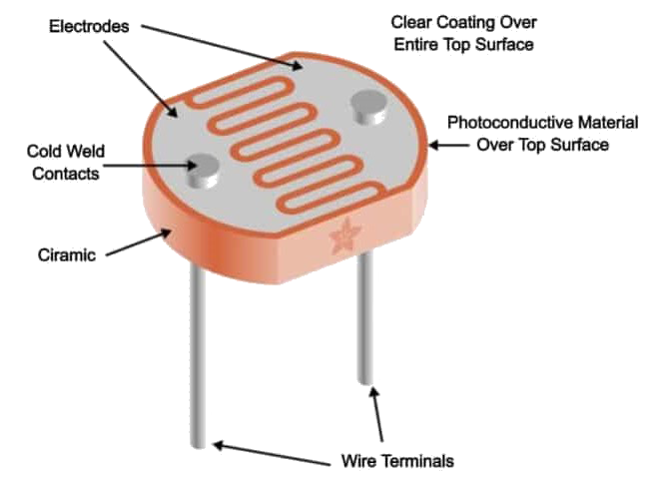
Sensors: LDR Sensor
An LDR or light-dependent resistor is also known as photoresistor, photocell, Photoconductor
It is one type of resistor whose resistance varies depending on the amount of light falling on its surface
It works on the principle of photoconductivity
When the light falls on its surface, then the material conductivity reduces and also the electrons in the valence band of the device cross the conduction band
Passive component, no external power required
One terminal connects to VCC and another to GND
Adjustable sensitivity (via blue digital potentiometer adjustment)
Output Digital – 0V to 5V, Adjustable trigger level from preset.
Operating Voltage: 3.3V to 5V DC.
Operating Current: 15ma.
Application:
Simple Smoke Detector Alarm, Clock with automatic light
Laser-based security systems
Solar Street Lamps, Camera light meters

Slide 16
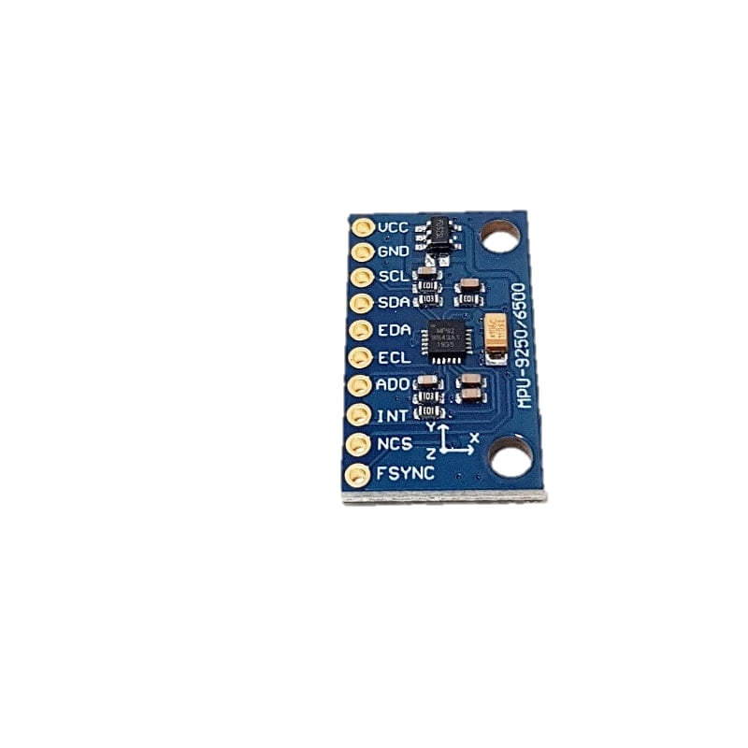
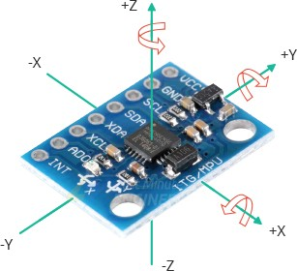
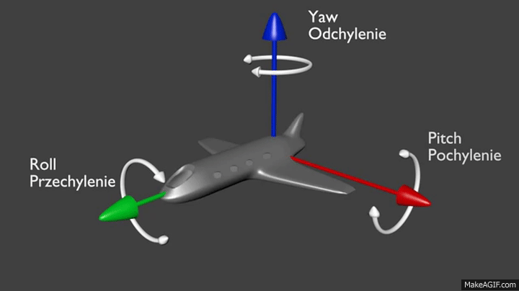
Sensors: Gyro Sensor
A Gyroscope measures the orientation and angular velocity of an object.
These can measure the tilt and lateral orientation of the object
There are three types of angular rate measurements:
Yaw- the horizontal rotation on a flat surface seeing the object from the Top
Pitch- Vertical rotation as seen in the object from the Front,
Roll- the horizontal rotation when seeing the object from Front.
Specification:
Power Supply: DC3.3V-5V
Chip: MPU9250
Gyro range : ± 250 500 1000 2000 ° / sec
Acceleration range: ± 2 ± 4 ± 8 ± 16g
Applications:
Car navigation systems
Auto stability control systems of vehicles
Motion sensing for mobile games,
Camera-shake detection systems in digital cameras, etc.

Slide 17
Sensors: Gyro Sensor
Pin | Function
VCC | Power supply
GND | Ground
SCL | Serial Clock Signal
SDA | Serial Data Input
EDA | External Data (master)
ECL | External Clock
ADO | Slave Address LSB, Serial Data Output
INT | Interrupt Digital output
NCS | Chip select
FSYNC | Frame synchronization digital input

Slide 18
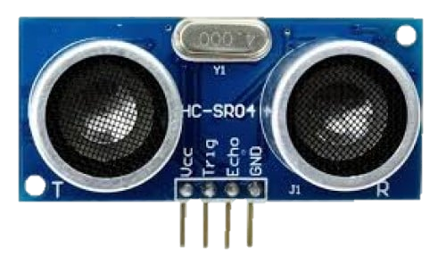
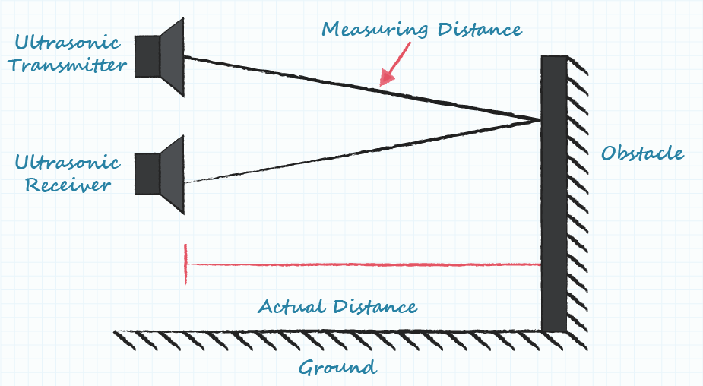
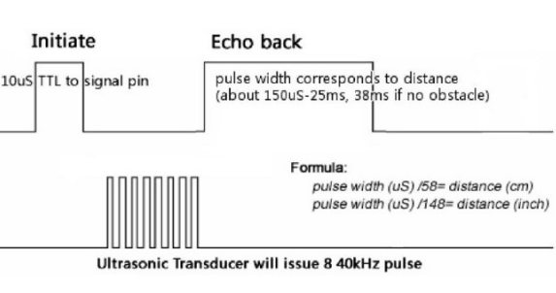
Sensors: Ultrasonic Distance Sensor
Used to measure distance
Works by reflecting ultrasonic sound waves (typically 40kHz)
2 eyes-like projects in the front, the Ultrasonic transmitter and Receiver
It is a transmitter, a receiver, and a control circuit in one single-pack
Excellent range accuracy and stable readings, operation is not affected by sunlight
The Trigger and the Echo pins are the I/O pins of this module
When the receiver detects the return wave the Echo pin goes high for a particular amount of time which will be equal to the time taken for the wave to return back to the sensor.
Ultrasonic Ranging Module HC-SR04 specification:
Distance: 2cm - 400cm non-contact distance sensing capabilities
Ranging accuracy: up to 3mm.
Power Supply: +5V DC
Effectual Angle: <15°
Resolution: 0.3 cm

Slide 19
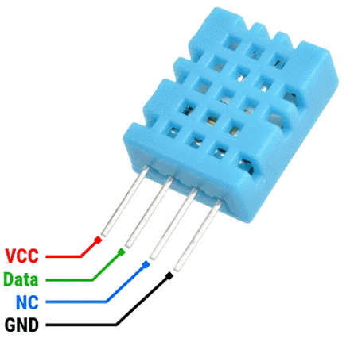
Sensors: DHT Sensor
Applications:
Dehumidifier,
Testing and inspection equipment, consumer goods, automotive,
Automatic control
Data loggers
Weather stations
Humidity regulator
The DHT-11 Digital Temperature And Humidity Sensor is a basic, ultra-low-cost digital temperature and humidity sensor.
Includes a resistive sense of wet components and an NTC temperature measurement device, and is connected to a high-performance 8-bit microcontroller
Digital sensor, data can be read digitally from data pin.
Pins:
VCC (Power Input) : 3.3V – 5V
GND (Ground)
DATA (Bi-directional communication for temperature and humidity data)
Specifications
Humidity Measuring Range(%) | 20 to 90
Temperature Measuring Range | 0 to +50
Humidity Measurement Accuracy | Â±5.0
Temperature Measurement Accuracy | Â±2.0
Response Time(s) | <5

Slide 20
Sensors: DHT Sensor
Data Format
Example:
0011 0101 0000 0000 0001 1000 0000 0000 0100 1101
Humidity: 0011 0101 = 35H = 53%
Temperature: 0001 1000 = 18H = 24 ℃
8-bit humidity integer | 8-bit Humidity decimal | 8 bit temp integer | 8 bit fractional temp | 8 bit parity bit

Slide 21
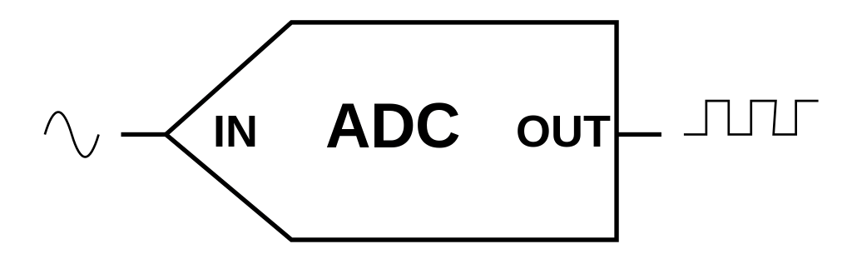
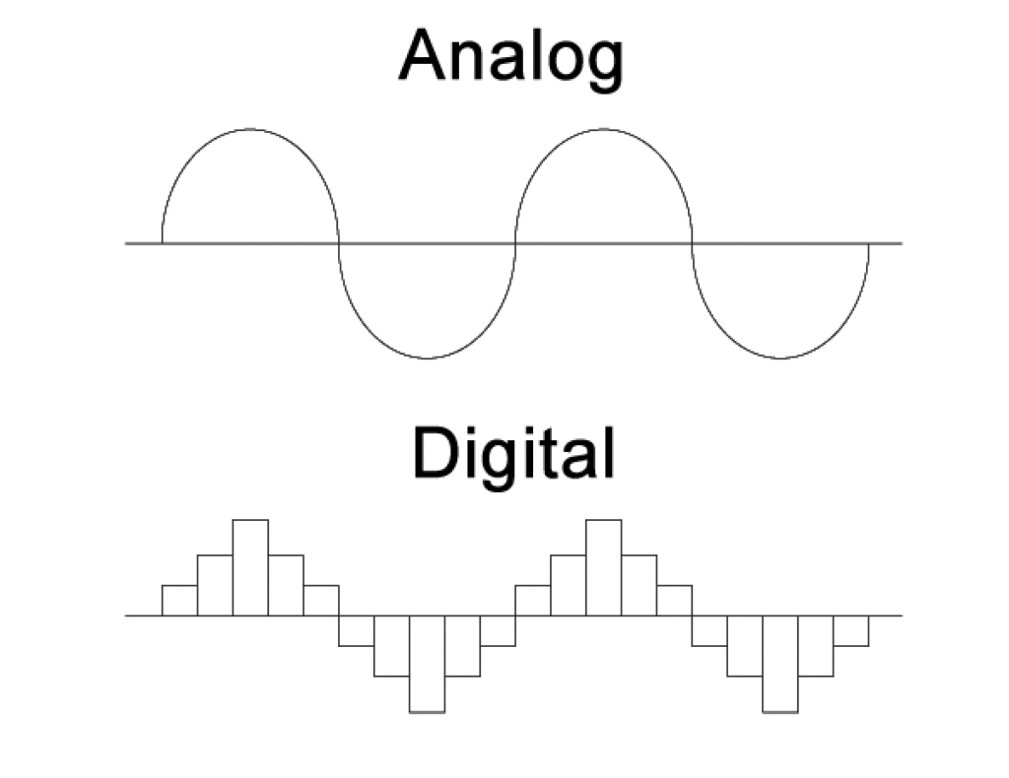
Need of ADC for Analog Sensors
Some sensors are analog sensors, which give the data in the form of an analog voltage, which is continuous, but Arduino like IoT devices can work on Digital signals
So to bridge this gap, some conversion is needed.
ADC can do that conversion.
Analog signal is continuous but digital has set of finite steps, so accuracy of data depends upon the number of output bits in ADC
10-bit ADC pins are built-in, in Arduino Uno board
For Ex:
Input voltage of 4V out of 5V for 10 bit resolution ADC,
Reading = (2¹⁰/5)∗4 = 1024*0.8 = 819.2 = 11 0011 0011
$ADC reading=\frac{2^{Resolution of ADC}}{Max Voltage}∗Analog input Voltage$

Slide 22
Actuators
An Actuator is a component of a machine that is responsible for moving or controlling a mechanism or system.
An Actuator requires a control signal and a source of energy.
The control signal is relatively low energy and may be electric voltage or current, pneumatic or hydraulic pressure or human power.
Actuators are greatly valuable devices and have an assorted scope of use in fields, such as, building, electronic designing and can be found in numerous sorts of hardware, for example, printers, autos.
Most actuators deliver either direct (straight line), revolving (round) or oscillatory movement.
Three types of Actuators
Hydraulic Actuators
Pneumatic Actuators
Electric Actuators
Energy
Actuator
Signal
Motion/Force

Slide 23
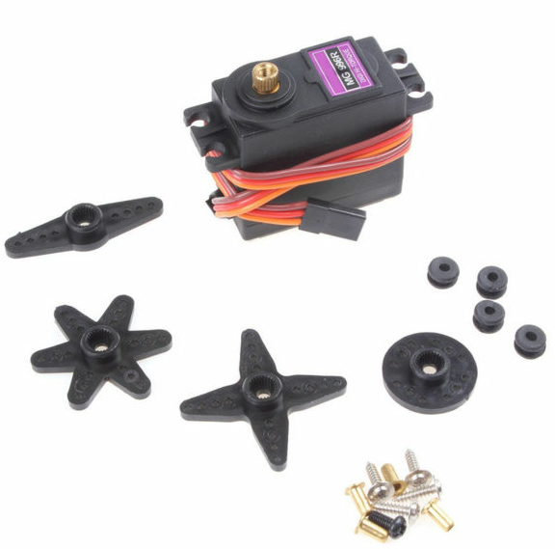
Actuators: Servo motor
Servo motor-controlled actuators provide precise and repeatable movements for industrial machines, utilized across many industrial applications, including those requiring high-precision positioning and cycling.
Servo actuators convert electrical energy into controlled mechanical motion.
Linear Servo Motor:
Move machine parts linearly, typically executing back-and-forth motions exert a mechanical force, facilitating straightforward linear movement
The core components include a rotary synchronous servo motor known for its high-speed rotational output.
This output is then amplified in terms of torque by gearboxes.
The rotary motion is converted into linear motion through mechanisms
like belts, leadscrews, or ball-screw assemblies
Rotary Servo Motor:
It excels in creating circular motion, either in fixed degrees or continuous rotation
The heart of these actuators is an electric motor, typically of the induction type, which effectively converts electrical energy into mechanical energy
This conversion results in rotational torque on the output shaft, a fundamental aspect for applications like mixers, fans, saws, and pumps.
When integrated with a position sensor, these motors can accurately circularly position payloads.
Voltage: Commonly 5V or 6V.
Input: Pulse-width modulation (PWM) signal.
Range: Typically 0 to 180 degrees
Internal feedback mechanism for accuracy.

Slide 24
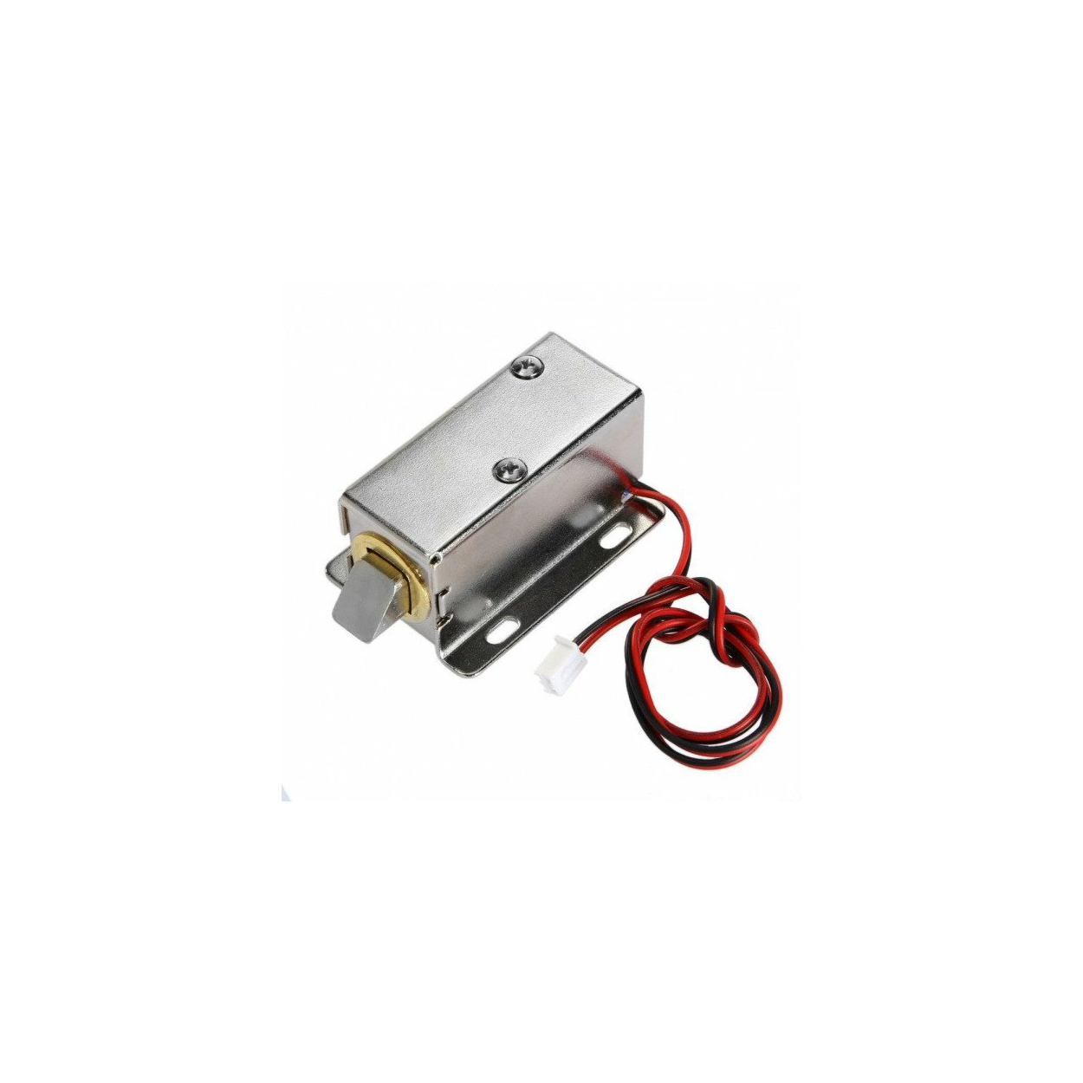
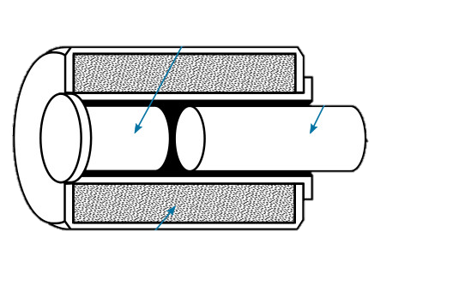
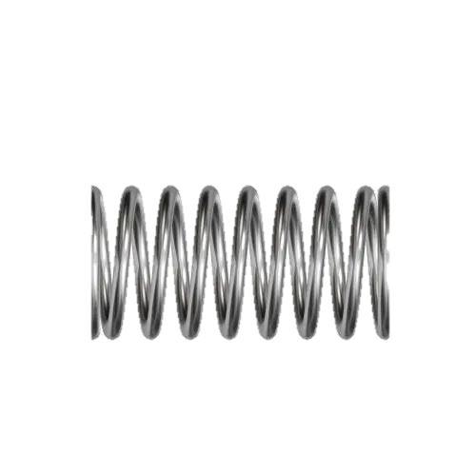
Actuators: Solenoid Lock
A solenoid actuator is a control device that uses electromagnetism to convert electrical energy into mechanical motion.
It is made of a movable coil and iron core. The strength of the Solenoid is determined by the number of turns on the coil.
An important aspect of the solenoid is a jolt.
A solenoid is an electromagnet formed by a conductor wound in a series of loops in the shape of a spiral
soft-iron core is pinned or held in an immovable position
A movable plunger (also soft iron) is held away from the core by a spring when the solenoid is de-energized, When current flows through the conductor, it produces a magnetic field.
The magnetic flux produced by the coil establishes north and south poles in both the core and the plunger.
The plunger is attracted along the lines of force to a position at the center of the coil.
The de-energized position of the plunger is partially out of the coil due to the action of the spring.
Binary control (on/off)
Voltage: Varies, e.g., 6V, 12V
Input: Electrical current for activation
Magnetic fields move a plunger
Core
Plunger
Coil

Slide 25
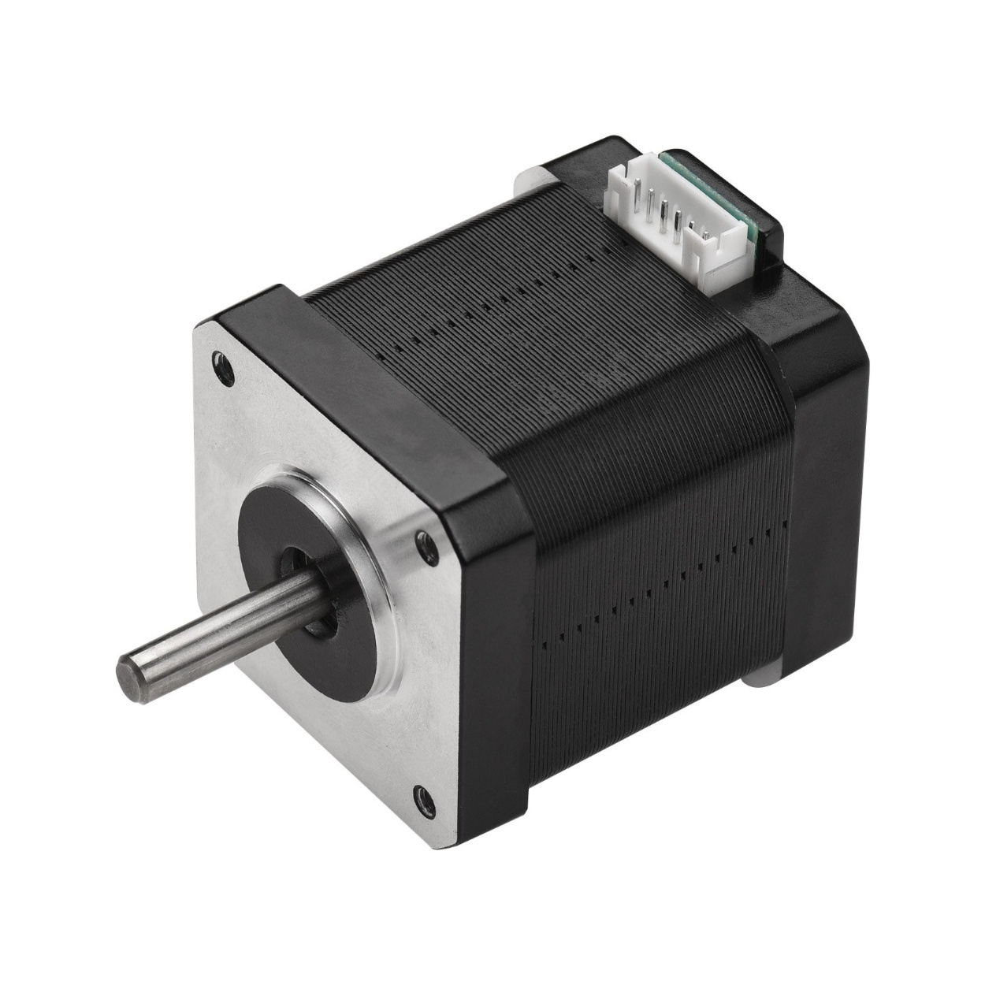
Actuators: Stepper Motor
Stepper motor actuators are more complicated than standard DC actuators and require a stepper controller to drive the motor
stepper motors are used in applications that require high-precision speed and position controls at the expense of a lower possible drive force
It divides rotational motion into an equal number of steps with the help of actuators, depending on the application requirement
Stepper motors offer consistent repetition of movement, speed control, and precision in positioning
They have several industrial applications such as 3D printing, robotics, CNC machining, medical imaging, and so on
Specification:
Rated voltage: 5V DC
Step Angle: 5.625° /64
Frequency: 100Hz
Self-positioning Torque: >34.3mN.m
Applications of Stepper motor:
Automotive gauges
Surveillance equipment such as cameras
Zooming functions in digital cameras
Blood analysis machines
Fluid pumps
Hospital beds
Stretchers and incubators

Slide 26
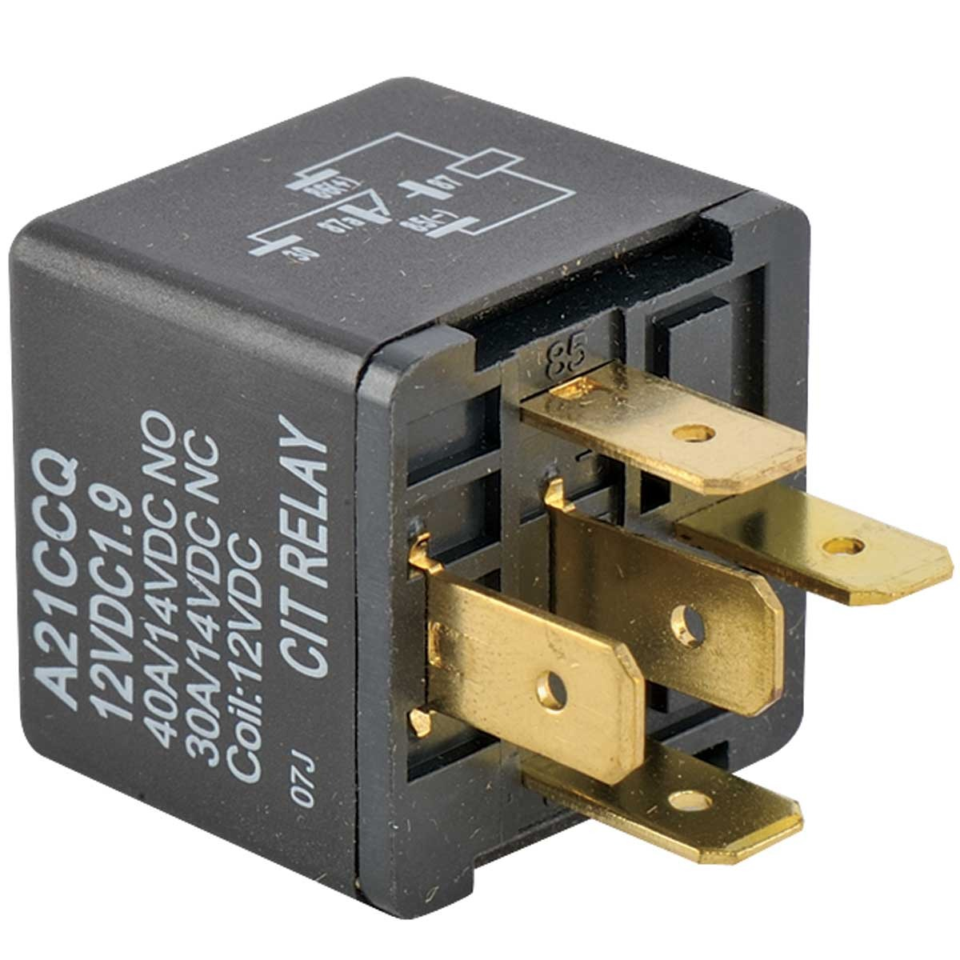
Relay
An electromechanical switch used to control high-power electrical devices using a low-power control signal
Types:
Electromagnetic Relay (EMR): Uses an electromagnet to operate the contacts.
Solid-State Relay (SSR): Uses semiconductor devices for switching without mechanical parts.
Voltage: Typically low voltage, e.g., 5V or 12V, depending on the relay type.
It switches electrical contacts capable of handling higher voltages and currents.

Slide 27
Need of relay while working with Actuators
Handle Voltage Differences: Actuators may require higher voltages incompatible with control circuits.
Provide Electrical Isolation: Protect control electronics from high-power actuator circuits.
Switch High Currents: Relays handle high currents, avoiding stress on control electronics.
Interface with Digital Systems: Enable easy integration into digital control systems.
Protect Control Circuits: Guard against back electromotive force and other potential issues.

